Slide 1
Building your Grant Budget
Office of Academic Grants and Sponsored Research
grants@tcnj.edu
Phone: 609-771-3255
Fax: 609-637-5171

Slide 2
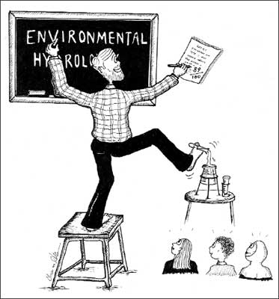
If you could have the ideal support for your scholarly work,
what would it be?

Slide 3
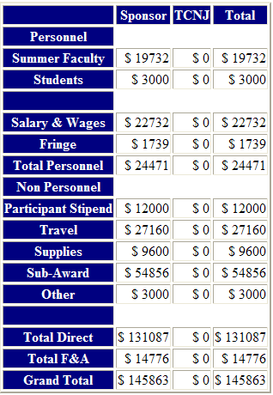
What can a grant help pay for?

Slide 4
Submitting Proposals at TCNJ - ERSPA
Step 1 - Submit the Early Notification
Step 2 - Develop the Proposal Budget
Step 3 - Develop the Proposal Narrative
Step 4 - Prepare the Proposal Routing form

Slide 5
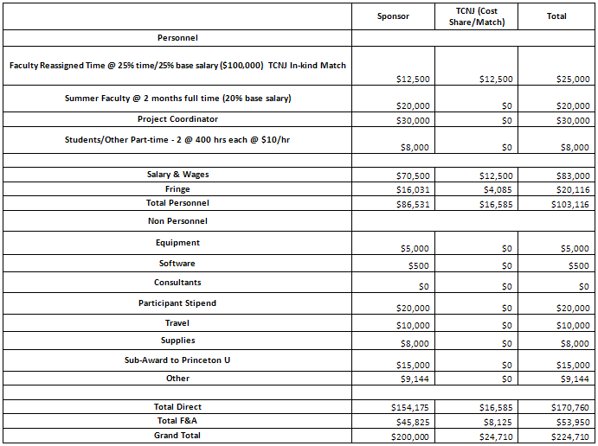
SAMPLE
BUDGET

Slide 6
Total Project Costs
Direct Costs (Directly benefit a specific sponsored project)
+
Indirect Costs (Cannot be attributed to a specific project)
------------------------------
= Total Project Costs

Slide 7
Elements of Direct Costs
Salaries and wages
Fringe benefits
Equipment
Expendable supplies and materials
Travel
Subcontracts
Consultants
External
Interdepartmental
Other

Slide 8
Generic Faculty Schedule Paradigm
Fall | Spring
T | T
T | T
T or RT* | T or RT*
D | D
Key
T = Teaching
D = Dedicated (to research, curriculum development, etc.)
*RT = Reassigned Time*
*Provost approval needed for TCNJ to cover the cost for RT on a grant, unless the RT is Dedicated

Slide 9
No. of FWH from Teaching (Max 18 FWH)
No. of FWH from Scholarship/Advising (Max 6 FWH)
Source

Slide 10
Elements of Indirect Cost (F&A)
Facilities & Administrative (Indirect) Costs:
Real costs incurred by the Institution
Cannot be easily identified to a specific project or activity
Infrastructure costs to maintain all of the work of the institution
Calculated as a % of a Base (At TCNJ: 65% of Salary and Wages)
Made up of both “Facilities” and “Administrative” costs

Slide 11
Facilities Components
Building Depreciation
Equipment Depreciation
Operations and Maintenance (utilities, maintenance, custodial costs, non-capital improvements)
Interest Expense (paid to external parties)
Library (books, library facilities and library administration)

Slide 12
Administrative Components
Departmental Administration
Dean’s Office, Dept Heads, Dept Administrative staff and administrative work of faculty (including bid and proposal preparation)
General Administration & General Expense
President or Chancellor, Institution-wide Financial Management and Business Services, Personnel Management, Safety & Risk Mgmt, etc.
Sponsored Projects Administration
Grant and Contract Administration, Cost Analysis, Patent Expenses
Student Services
Registrar, Bursar, Student Medical
Typically supports and is allocated to Instruction

Slide 13
Allocation of Recovered F&A (Indirect Costs): FT3
Facilities and Administrative Costs (F&A). The recovery of facilities and administrative costs (also known as indirect costs) from sponsored activities is normally allowed based on the approved institutional negotiated rate with the cognizant federal agency. Until Fiscal Year 2002, 100% of recovered F&A costs went to The College’s general funds. As an incentive for faculty, departments, and schools to develop and submit competitive proposals to external sponsors and to promote other scholarly activities, the recovered F&A costs are now allocated to academic departments and schools as follows:
School ……....…………………………………………………………………………..…….25%
Department, Unit, or Interdisciplinary Centers/Institutes……………15%
College (general funds)………………………………………………………………….30%
Academic Affairs…….……………………………………………………………….…….30%
Actual reimbursements can be cancelled or changed in a particular budget year if warranted by extraordinary institutional fiscal considerations as determined by the Cabinet.

Slide 14
FT3 Distribution

Slide 15
QUESTIONS

